Slide 1
1st Grade Text Talk
Unit 3

Slide 2
I can use words I learn from a text.
Notes:
Goal-
Students need to engage with the goal- read it, repeat it, write it, etc.

Slide 3
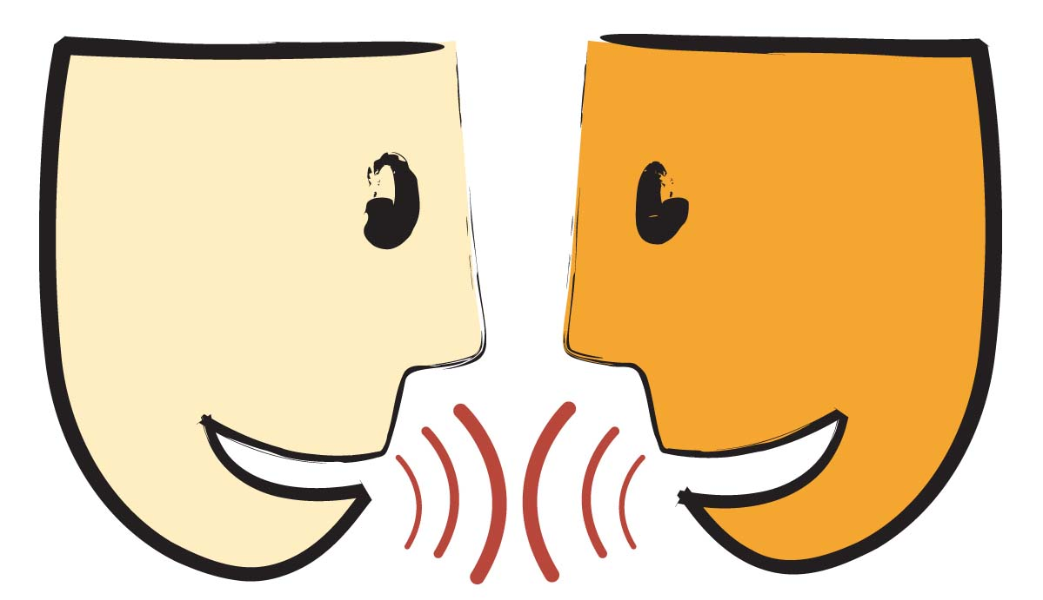
Tell your partner about a new word you learned last week.
Notes:
Access Prior Knowledge- (APK)
Turn and Talk

Slide 4
Notes:
New Information-
Read the book- provide a brief explanation of any words that may be new or unfamiliar to the students.

Slide 5
flashy
Notes:
Contextualize the word- Find it in the text
Say the word together

Slide 6
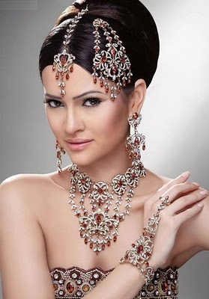
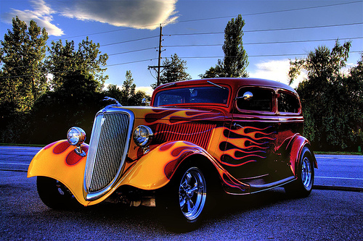
flashy
Fancy or showy
Notes:
Give student friendly definition
Use the word in other contexts

Slide 7
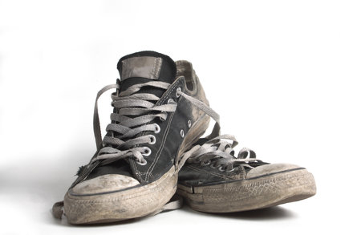
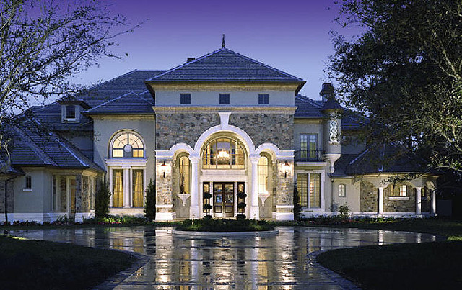
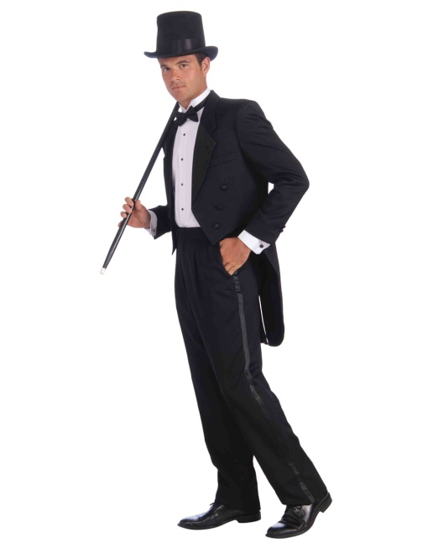
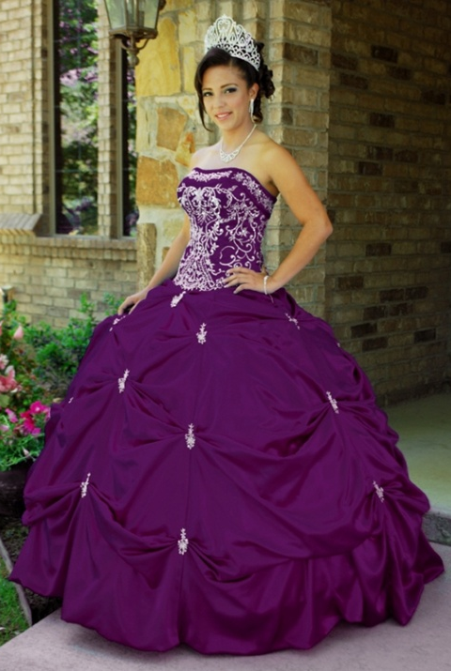
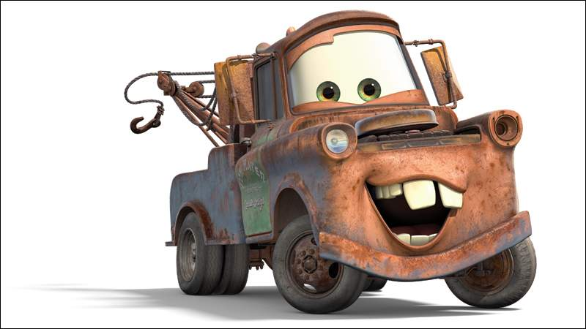
Which pictures show something flashy?
Notes:
Engage the students with the word

Slide 8
nasty
Notes:
Contextualize the word- Find it in the text
Say the word together

Slide 9
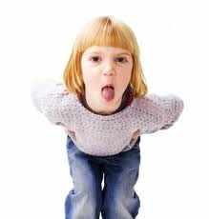
nasty
Disgusted or rude
Notes:
Give student friendly definition
Use the word in other contexts

Slide 10
What would your face look like if you just ate something that tasted nasty?
How did the Hare behave nasty toward the Tortoise?
Has anyone ever been rude or nasty toward you?
Notes:
Engage the students with the word

Slide 11
bolted
Notes:
Contextualize the word- Find it in the text
Say the word together

Slide 12
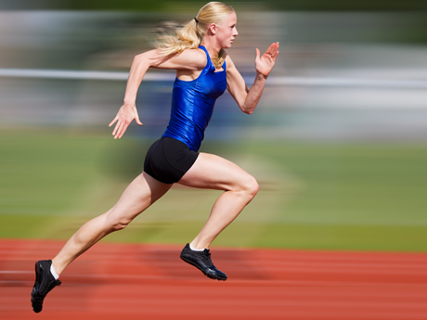
bolted
Run away suddenly
Notes:
Give student friendly definition
Use the word in other contexts

Slide 13
Thumbs up if this is an example bolted.
Thumbs down if not.
Your dog just raced out of your yard and ran away down the street!
The snail slowly moved across the floor.
The turtle walked slowly across the road.
The lady ran as fast as she could to get away from the snake!
Notes:
Engage the students with the word

Slide 14
Who can use all 3 words in a sentence?
flashy
nasty
bolted
Notes:
Read all three words and see if you can use them in one sentence.

Slide 15
Draw a picture to show you know what these words mean.
flashy
nasty
bolted
Notes:
Application-
Students need an opportunity to use the words they just learned from the text.

Slide 16
I can use words I learn from a text.
Notes:
Goal-
Revisit the Goal

